Slide 1
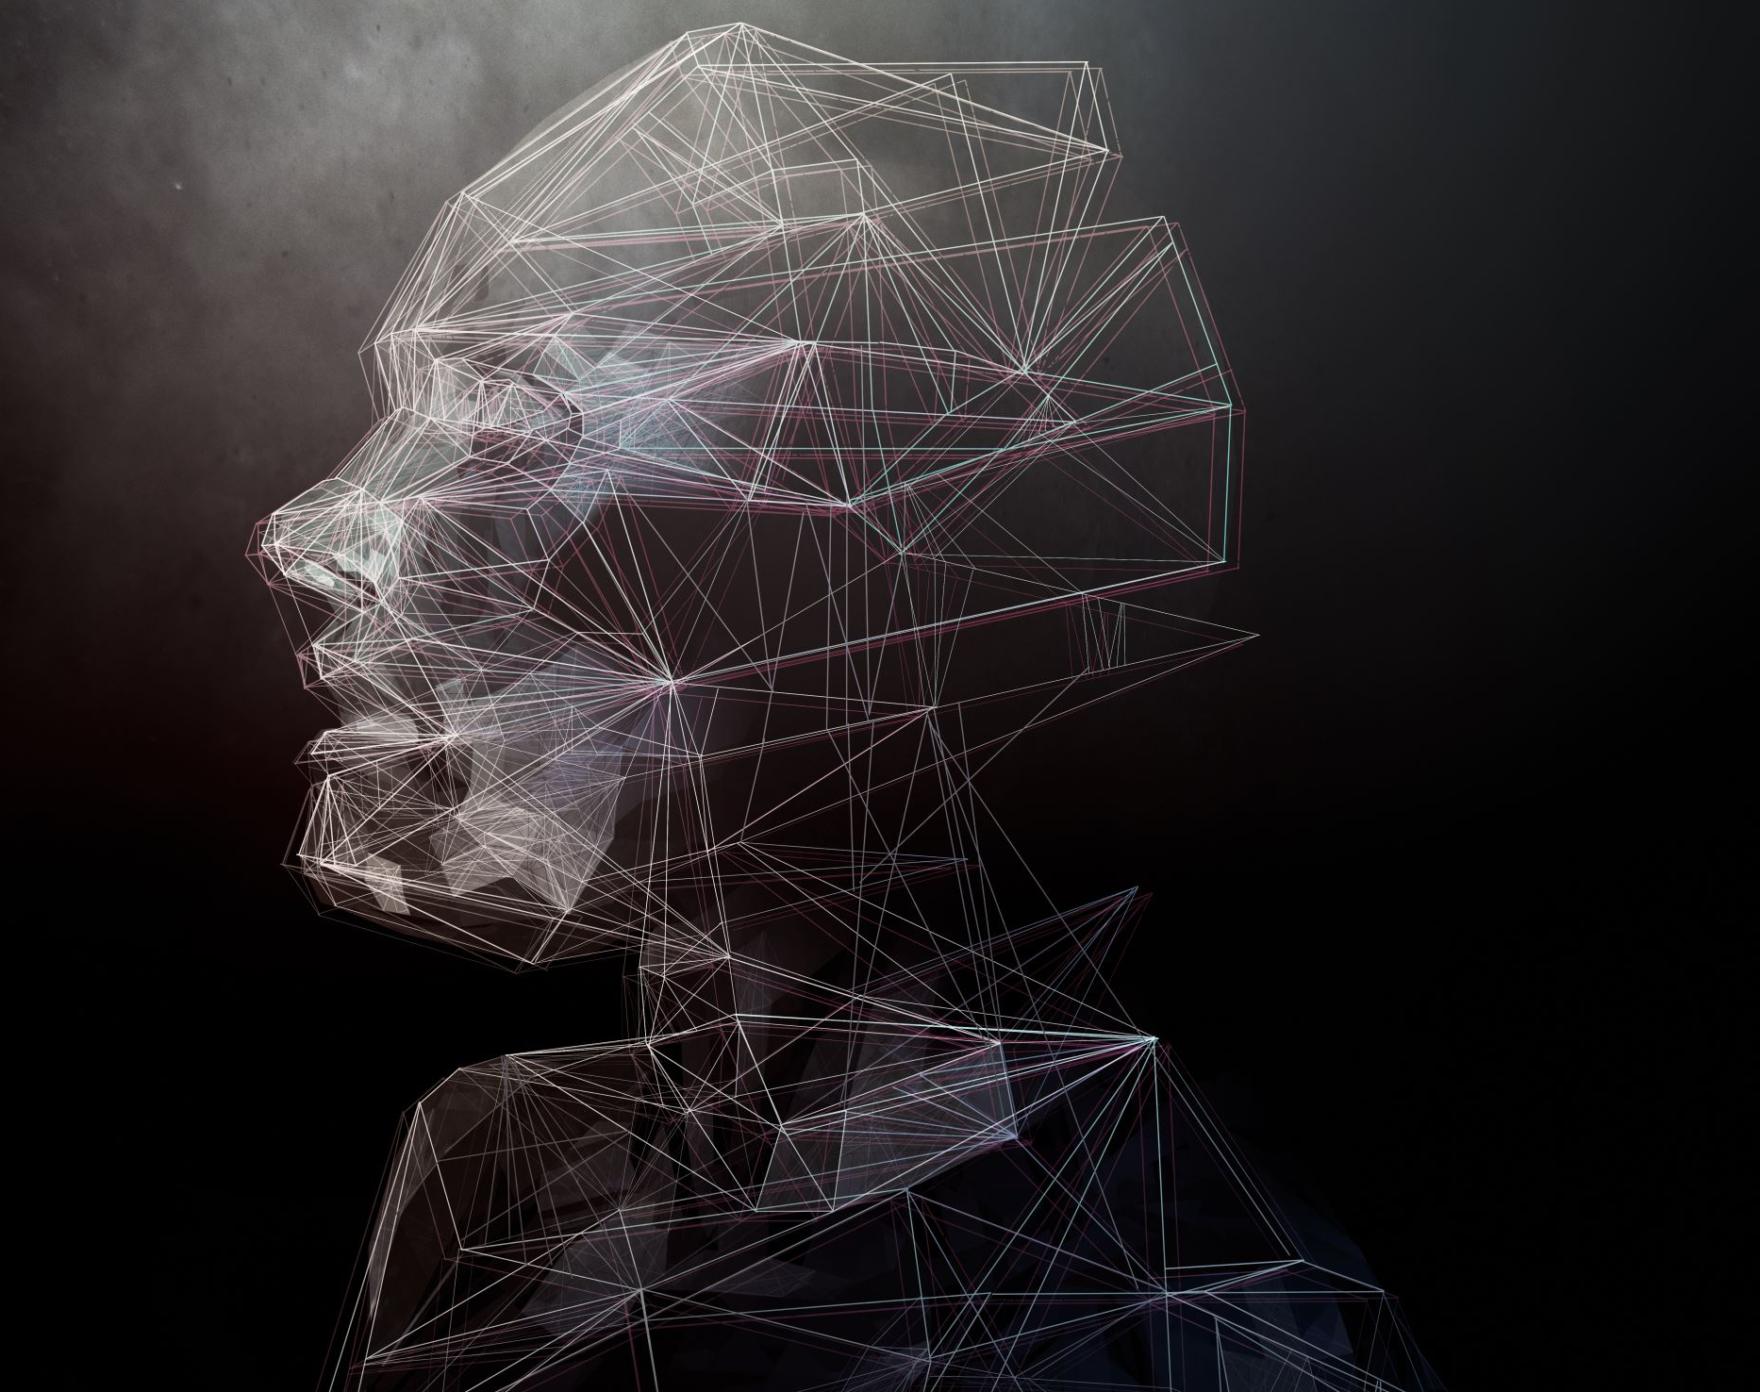
Facial Recognition and DeepFakes
By: Austin St-Jean

Slide 2






Agenda
What is Facial recognition technology
How is it used in our common day
Phones and their impact on the technology
How does it work
What are the dangers and Concerns
Deepfakes what are they
How do they work

Slide 3
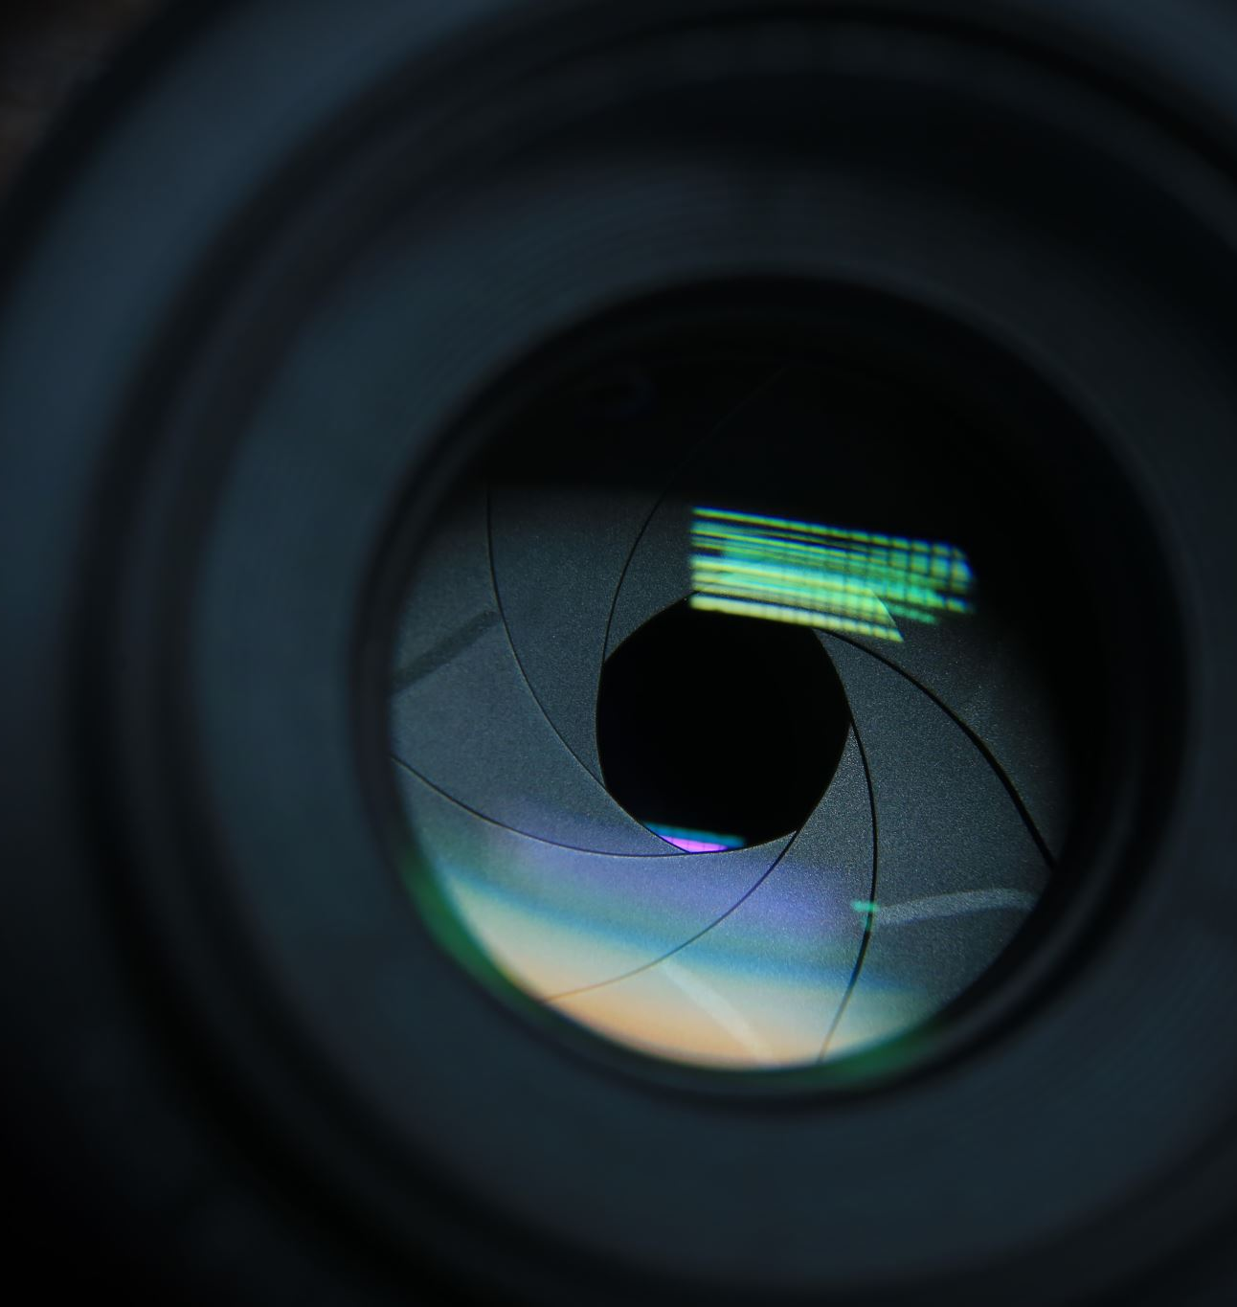

What is Facial recognition technology
Involves capturing, analyzing, and comparing facial patterns using algorithms.
Analysis: Mapping faces, creating a "faceprint" using measurements, shapes, and distances.
Recognition: Confirming a person's identity by cross-referencing with a database.
Originated in the 1960s with Woodrow Wilson Bledsoe's classification system.

Slide 4
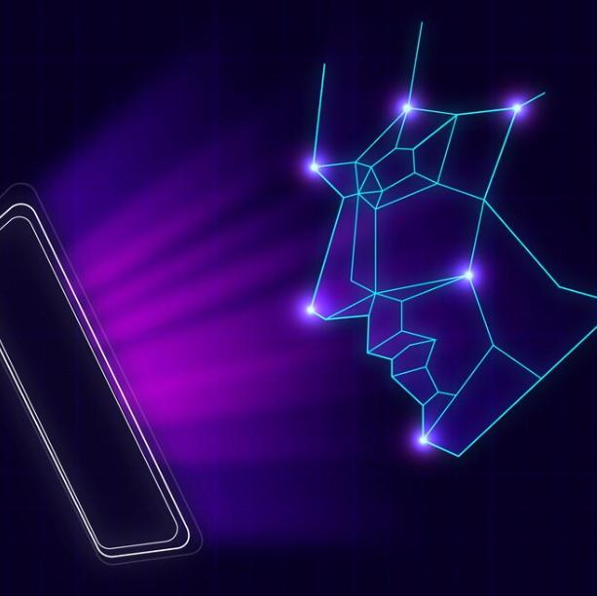
How is it used in our common day
Examples include travel, retail, public safety, healthcare, smart cities, smart homes, events, and consumer applications.
Integration with emerging technologies like AI, 5G, and IoT.
In 2022 and beyond, facial recognition is expected to be more prominent, with 1.3 billion devices using it by 2024, according to Juniper Research.
Provides authorization to people to grant or deny access.
Notes:
Image by <a href="https://www.freepik.com/free-vector/abstract-flat-face-recognition-background_4715223.htm#query=facial%20recognition%20phone&position=4&from_view=search&track=ais&uuid=c516748a-cf2f-4071-b401-f472b5cd79d4">Freepik</a>

Slide 5
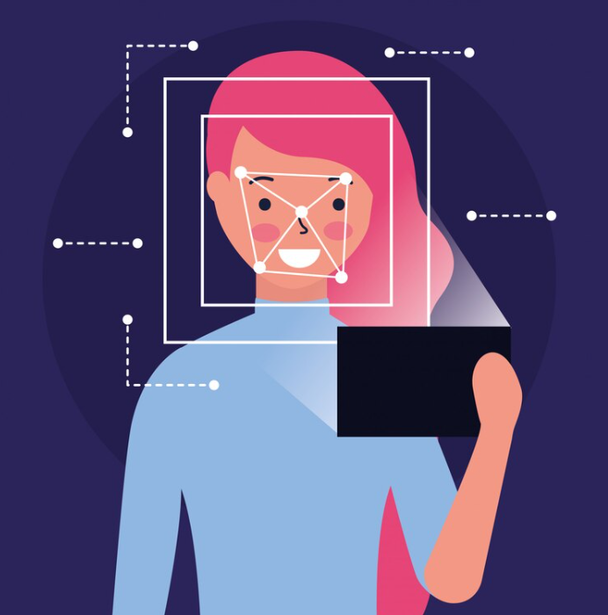
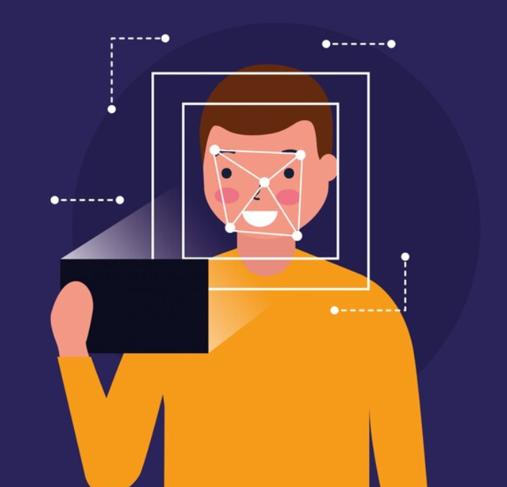
Mobile Devices
What impact do they have?
Likely used everyday
Database Images
Increase in security
Incredibly accessible
Facial Recognition is most common in mobile devices
Notes:
<a href="https://www.freepik.com/free-vector/man-face-scan-biometric-digital-technology_5597096.htm#query=facial%20recognition&position=9&from_view=search&track=ais&uuid=24a19ae6-1c76-40df-ac12-5d75fde96b74">Image by gstudioimagen</a> on Freepik
<a href="https://www.freepik.com/free-vector/woman-face-scan-process-gadget_5597097.htm#query=facial%20recognition&position=8&from_view=search&track=ais&uuid=24a19ae6-1c76-40df-ac12-5d75fde96b74">Image by gstudioimagen</a> on Freepik

Slide 6

How does Facial Recognition work?
Analysis: Scans your face creating nodes at important positions on your face. It calculates the distances between certain facial features such as the distance from your nose to your eye, distance between both your eyes, length of your head, length of your mouth, distance of your jaw etc. It also notes important shapes and distinct facial features such as freckles.
Recognition: Once it has all the numbers to compares to answers to a database. Once it finds a match it will confirm or deny access to whatever the user is accessing.
Notes:
Image by <a href="https://www.freepik.com/free-vector/abstract-flat-face-recognition-background_4715235.htm#query=facial%20recognition&position=19&from_view=search&track=ais&uuid=c6ecd9c8-05d1-4dc4-9bb6-ba84b007839b">Freepik</a>

Slide 7

What are some concerns?
Raises privacy concerns related to unauthorized surveillance.
Potential misuse for surveillance, profiling, or tracking without consent.
Legal concerns about privacy violations, data protection, and consent.
Potential misuse by law enforcement
When in public your face is ALWAYS scanned.
False Positives
If granted access to unauthorized personnel, there is nothing to prevent them from causing further harm.
What is someone can convincingly pretend to be someone else? Deepfakes?
Notes:
<a href="https://www.freepik.com/free-vector/mobile-face-scan_5597119.htm#query=facial%20recognition%20security&position=19&from_view=search&track=ais&uuid=edd1f986-586c-4dfa-b05b-3bcaf8b5ba28">Image by gstudioimagen</a> on Freepik
False positives
Main goal: To be more secure
In public face is ALWAYS scanned

Slide 8
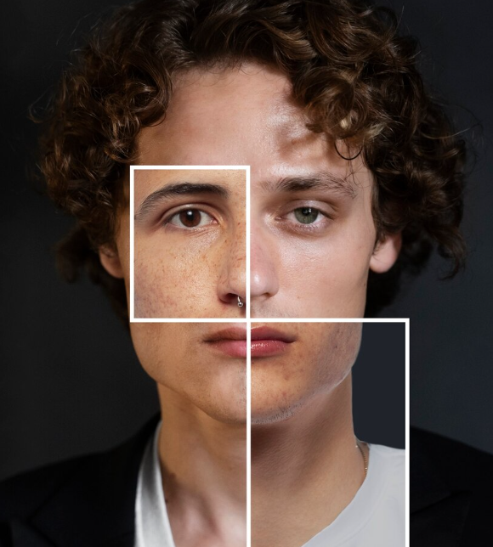

Concerns continued… Deepfakes
A piece of media in which someone’s face has been digitally altered so they appear as someone else.
Intentional infliction of emotional distress, defamation, false light, and harassment.
Celebrities may not own copyrights therefore it’s fair use for deepfake creators.
Difficult to track deepfake creators, as deepfake content can be uploaded anonymously.
Pornography
Very accessible and can be utilized by someone with little to no technical skill.
It is believed that by 2026 90% of online media will be deepfakes. Making a very blurred line of what is fiction and what is fact. It can cause a disconnect where citizens no longer have a shared reality.
Notes:
https://commons.wikimedia.org/wiki/File:Morphing_madness.jpg
What is it: A piece of media in which someone’s face has been digitally altered so they appear as someone else.
Main use: Celebreties, Pornography, any social media post
Issues: Difficult to track deepfake creators, as deepfake content can be uploaded anonymously.
Becoming increasingly popular and being used in other things such as advertising and political campaigns

Slide 9
So what is happening behind the scenes?

Slide 10
Facial Recognition Algorithm
MobileViT
Embedding Layer: Patches are fed to it, and it performs a linear projection on each patch resulting in a set of vector which is called a token. This is represented as a two-dimensional matrix. Example: [197, 768]. 197 represents the number of tokens and 768 is the token dimensions.
Transformer Layer: Token passes through layer normalization. Only output corresponding to the class token will be extracted. Passes the output classification then is passed to the MLP head.
MLP Head: Final layer responsible for classification. Uses a Softmax function which measures the importance of low-level capsule features to high-level capsule features. Example if the mouth is a prominent feature, it will be represented as a larger weight. Then processes the output to obtain the final classification result.
Notes:
MobileViT, a light-weight and general-purpose ViT for mobile devices, is introduced. MobileViT presents a different perspective for the global processing of information with Transformers
a light-weight and general-purpose ViT for mobile devices
Embedding layer: Separates image into different patches and creates

Slide 11
Deepfake Algorithm
Different spatial features are merged together to get an optimal representation of video.
Highlights gradient information and texture variations in specific facial areas (forehead, nose, cheeks).
Uses an extraction method called HOG-Based CNN.
Histograms are created for each cell. Represent vectors and configure the overall HOG visual feature.
Divides the image into spatial blocks and computes gradient magnitude and orientation for each cell. Calculates horizontal and vertical gradient information of each pixel.
Notes:
End goal: Different spatial features are merged together to get an optimal representation of video.
Does this by: Highlights gradient information and texture variations in specific facial areas (forehead, nose, cheeks).

Slide 13
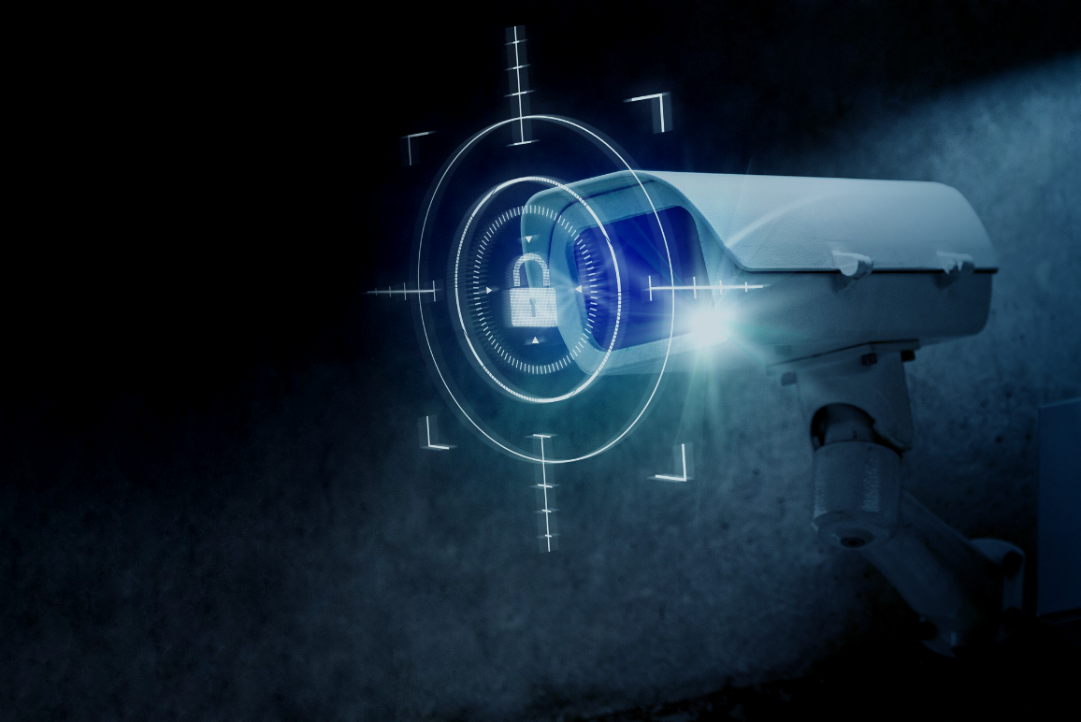
What can you do to protect yourself?
It is too early to tell how exactly you can protect yourself
Simple answer is no there is no real way to protect yourself currently
Don’t upload images or videos of your face to completely avoid this.
Companies like Youtube are enforcing that if a video was deepfaked it be marked and if not then it will be taken down. Countries such as the UK and China are taking a similar approach.
Countries are trying to relegate laws to combat it but its evolving so fast that its difficult to find an answer.
Notes:
<a href="https://www.freepik.com/free-photo/cctv-security-technology-with-lock-icon-digital-remix_15667451.htm#query=protect%20camera&position=0&from_view=search&track=ais&uuid=7e2cb13d-4c50-4b37-a4e5-a6738919debd">Image by rawpixel.com</a> on Freepik

Slide 14






Biggest takeaways
Phone are the most common point of entry for most people
Facial recognition is used for authorization
Analysis & Recognition
Videos are no longer believable
Be cautious of where you upload your images
Can be dangerous if used incorrectly
There is no concrete way to protect yourself currently

Slide 15
Thank you for listening

Slide 16
Sources
https://www.nec.co.nz/market-leadership/publications-media/what-is-the-future-of-facial-recognition-technology-in-2022-and-beyond/#:~:text=Facial%20recognition%20solutions%20are%20expected,other%20high%2Dend%20authentication%20tasks.
https://www.nytimes.com/wirecutter/blog/how-facial-recognition-works/
https://www.britannica.com/technology/deepfake
https://www.honigman.com/the-matrix/the-legal-issues-surrounding-deepfakes
Xu, Xuebin, et al. “A high‐performance and Lightweight Framework for Real‐time facial expression recognition.” IET Image Processing, vol. 17, no. 12, 2023, pp. 3500–3509, https://doi.org/10.1049/ipr2.12881.
Ismail, Aya, et al. “An integrated spatiotemporal-based methodology for Deepfake Detection.” Neural Computing and Applications, vol. 34, no. 24, 2022, pp. 21777–21791, https://doi.org/10.1007/s00521-022-07633-3.
Gil, Rosa, et al. “Deepfakes: Evolution and trends.” Soft Computing, vol. 27, no. 16, 2023, pp. 11295–11318, https://doi.org/10.1007/s00500-023-08605-y.
Lijuan, Yan, and Zhang Yanhu. “A face recognition algorithm based on the combine of image feature compensation and improved PSO.” Scientific Reports, vol. 13, no. 1, 2023, https://doi.org/10.1038/s41598-023-39607-3.

